Slide 1

Planning and Designing Your First Smart Pixel Christmas Light Show

Slide 2
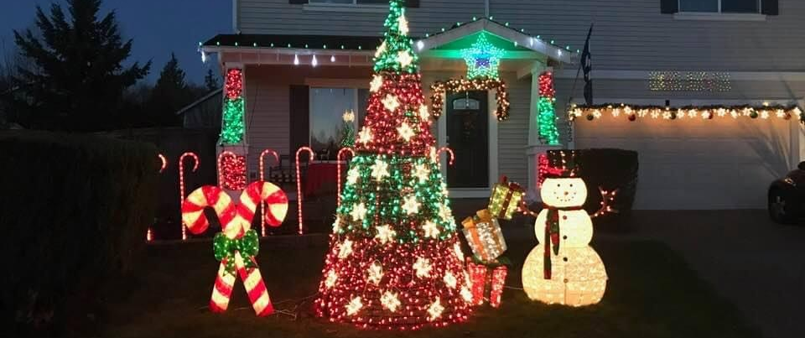
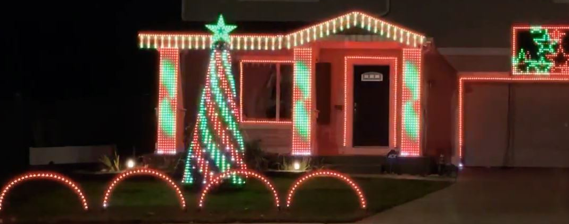

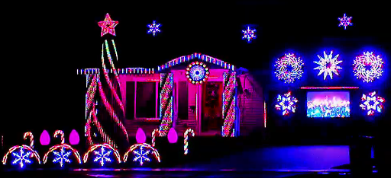
Our Journey

Slide 3
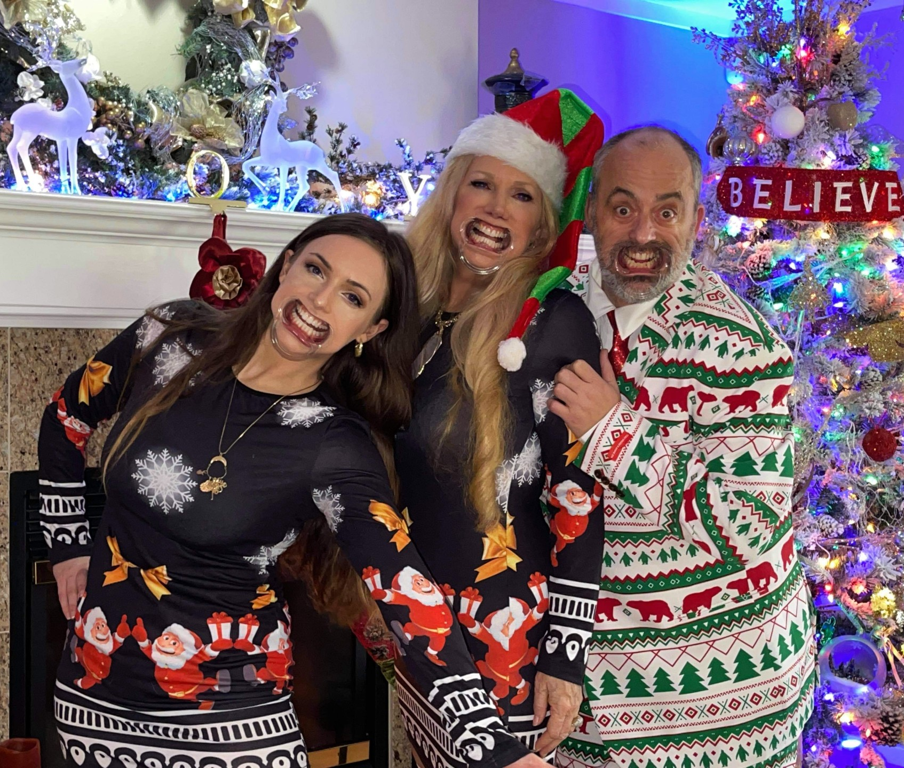
Agenda
Safety
Putting your show on paper
Determining what to order
Time management
Cost
Is my neighborhood right
How do I want my show to look
What type of props
What type of lights
What type of controllers
Where do I get help

Slide 4
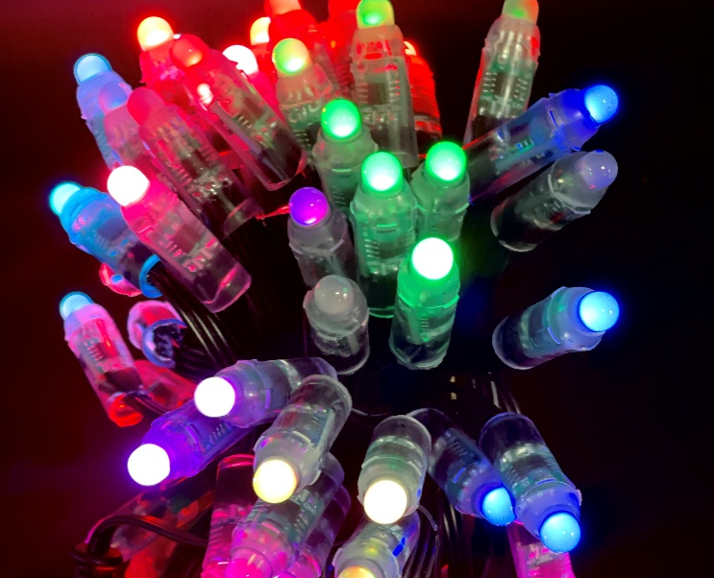
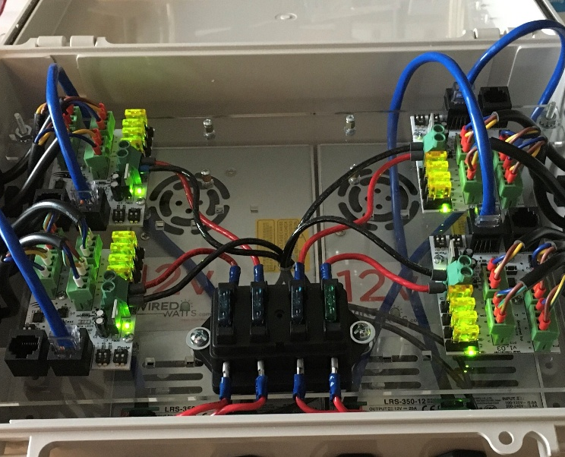
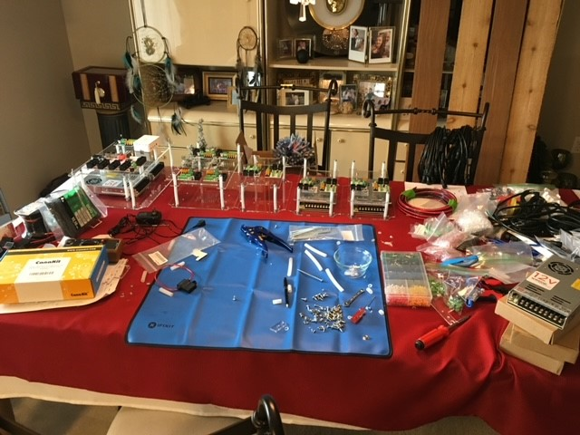
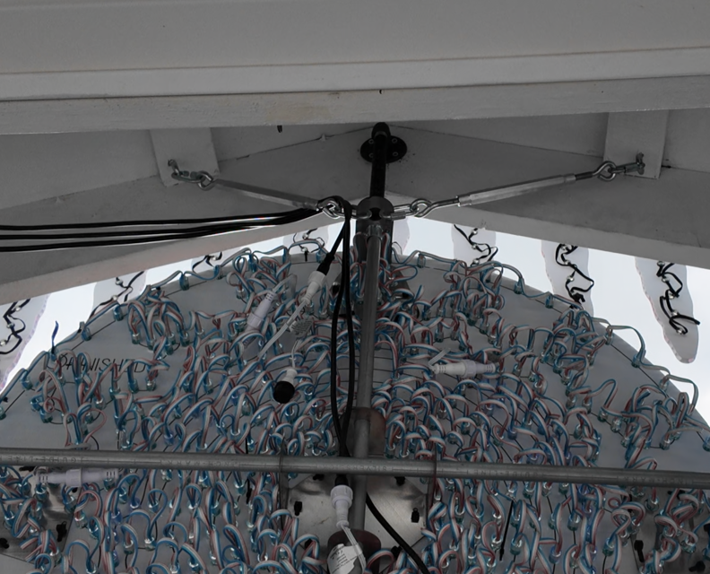

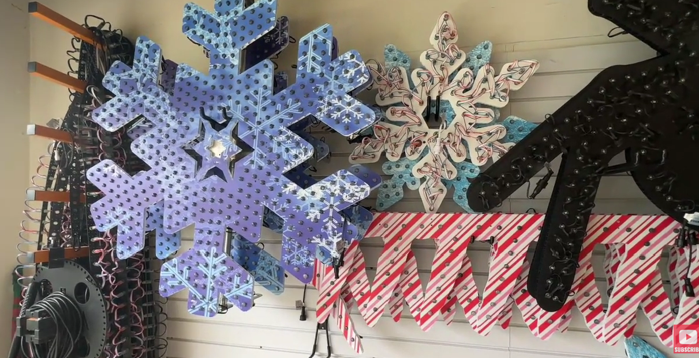
Cost
PIXELS
CONTROLLERS
WIRE / DATA CABLE / PIGTAIL
POWER SUPPLIES
PROPS
MEGA TREE PARTS
MOUNTS
ZIP TIES
TAPE
TOOLS
SOLDER, SLEAVES /SHRINK WRAP
PIPES (METAL & PCV)
SHOW CONTROLLER ( PI )
MUSIC / SEQUENCES
XLIGHTS DONATIONS

Slide 5
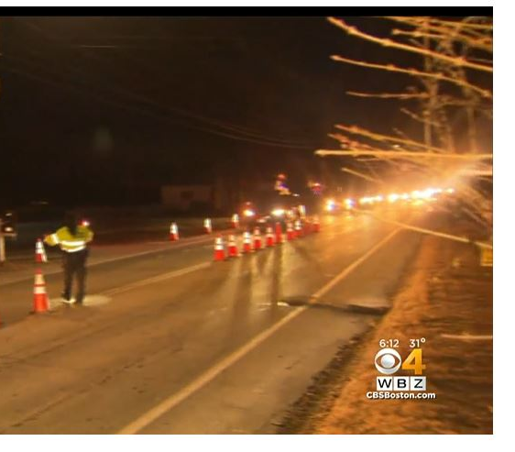
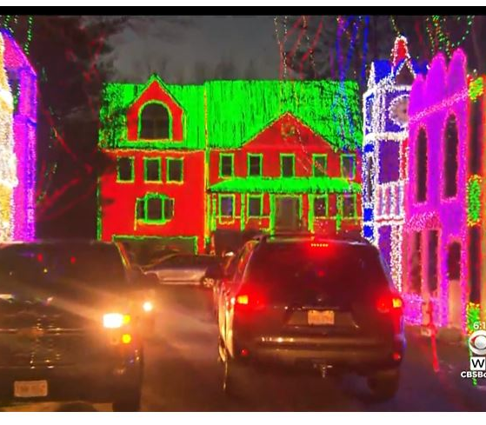
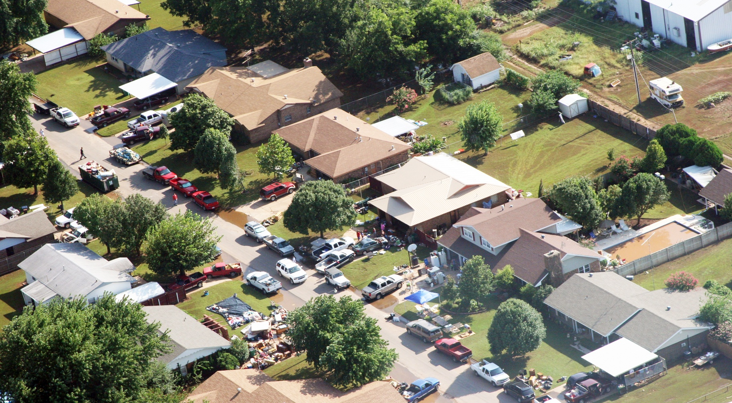

Is My Neighborhood Right?
Are there rules preventing this type of display (HOA & City)
Is There room for show traffic.
How are my neighbors
This Photo by Unknown Author is licensed under CC BY-SA

Slide 6
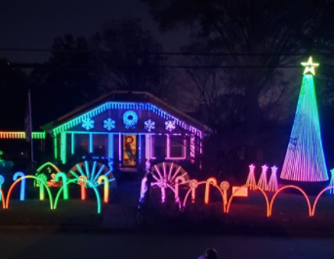
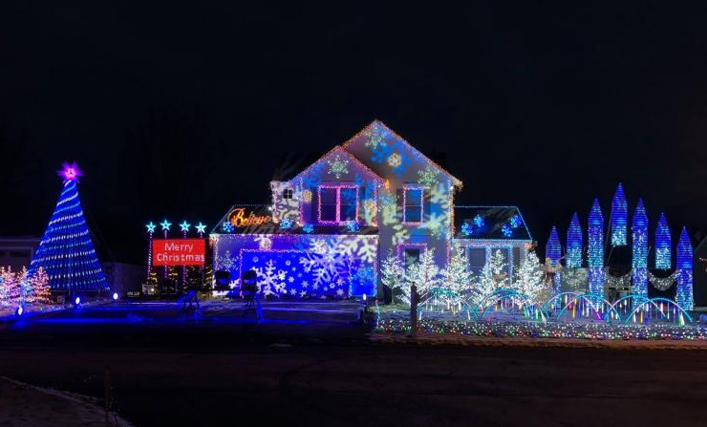
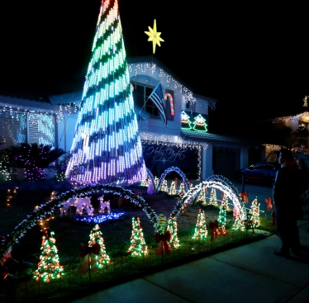
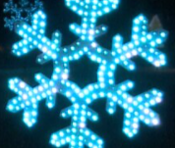
How do you want your show to look
Watch YouTube videos
What props must you have
Keep track with a notebook or folder on your computer of your favorites.
Leave question on videos or Posts, to the creator to find out specifics of a prop, spacing of lights, number of lights per string, size and mounting.
Find out if it was a free, created or bought sequence.

Slide 7
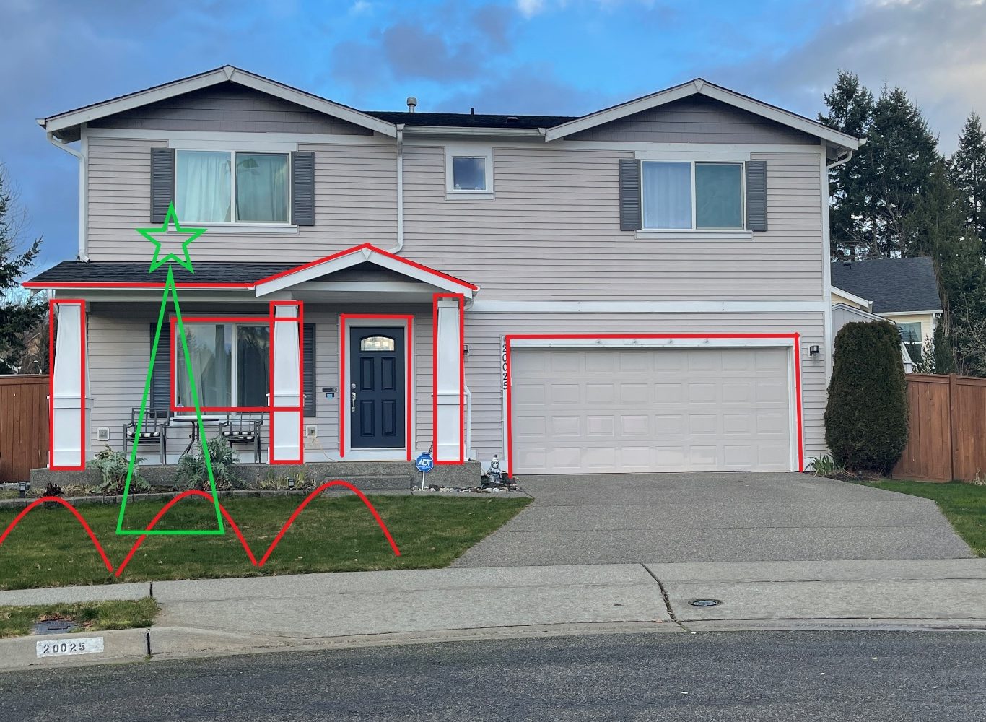
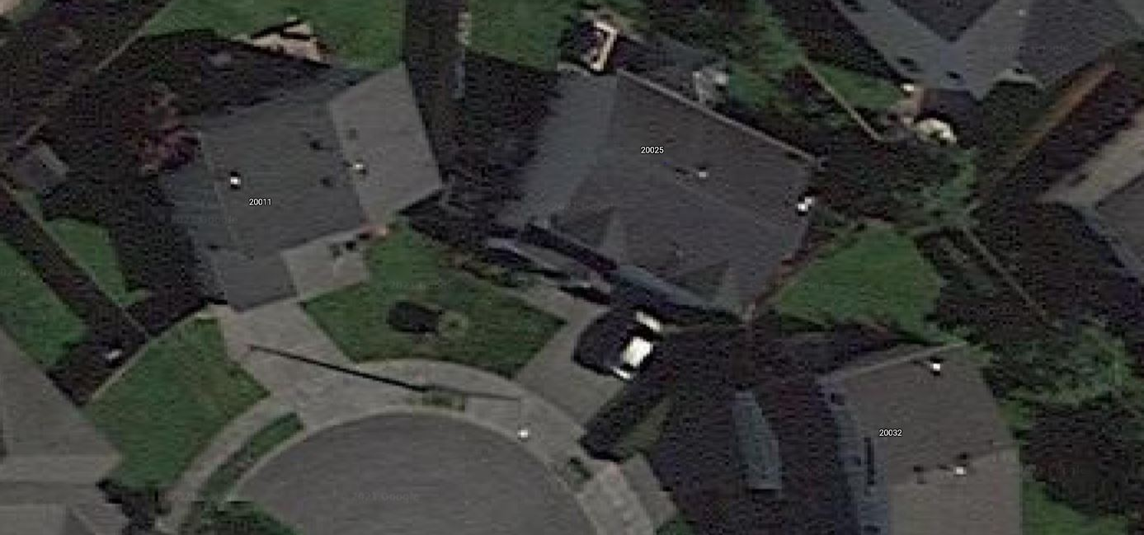
How do you want your show to look
Take Pictures of you house from the angles people will be watching you show from
Draw in the props you would like to have
Take measurements
Note the type of material you will be mounting your props to.
  Metal
  Brick
  Vinyl siding
  Wood
  Stucco

Slide 8
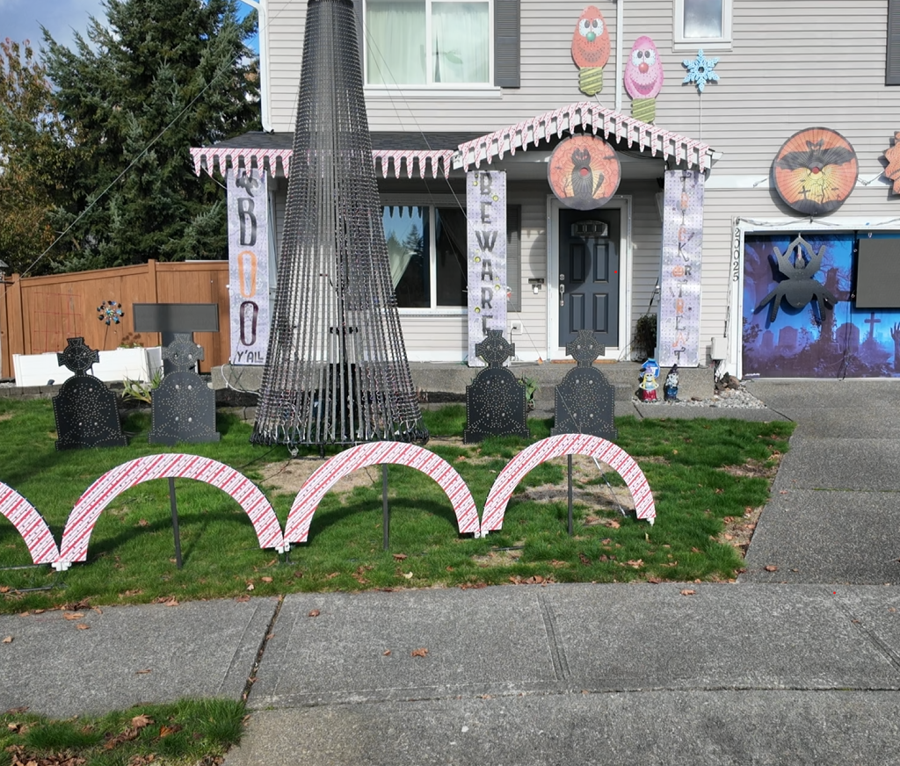
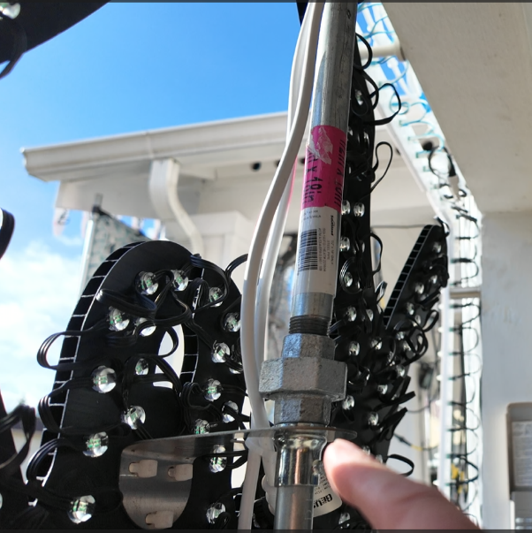
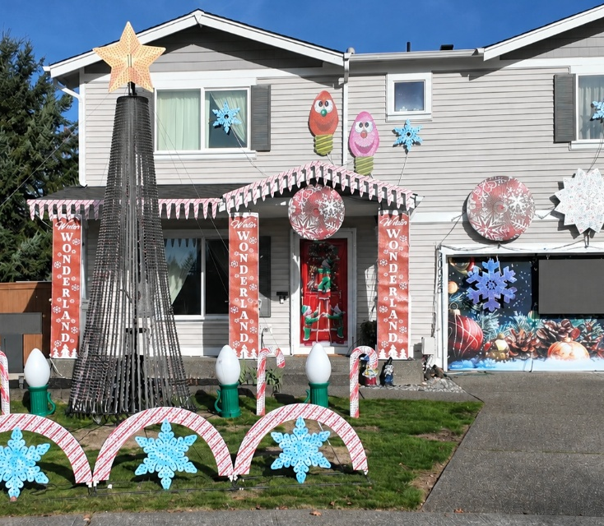
Are you doing Halloween and Christmas
Try to leverage similar layouts and controller locations
Skins can stretch your budget.

Slide 9
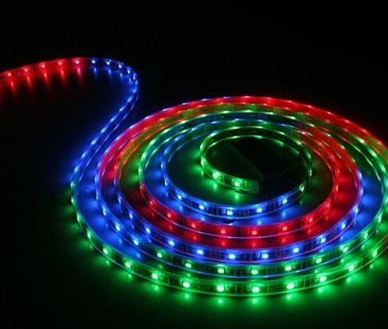
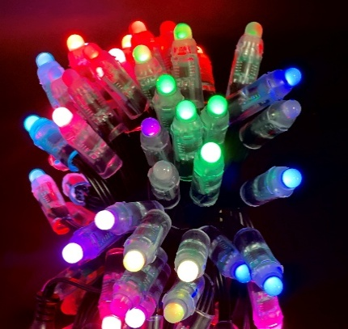

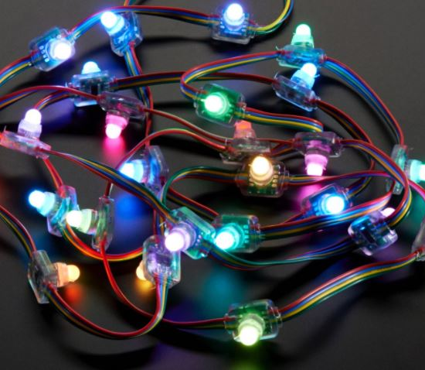
Lights / Props Controllers & Vendors
Lights
  Square, Bullet, seed, EVO
  5, 12 or 24 Volt
  Regulated or Resistor
  Standard or custom length
  X-connect, Ray Wu, Paul Zhang
Props & Mounts
  DYI / 3D printing
  Covert old AC props to LED props
  Coro

Slide 10
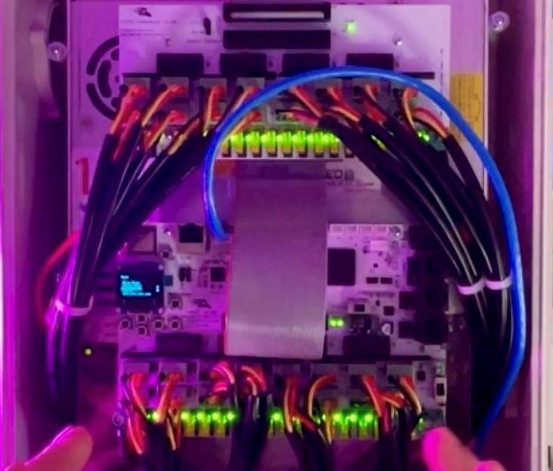
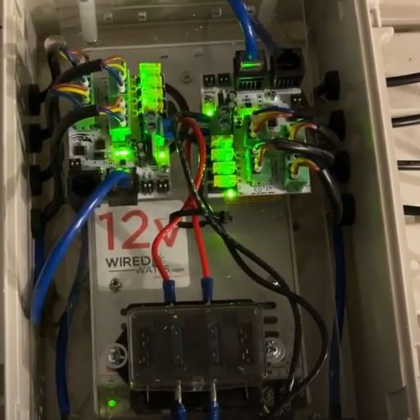
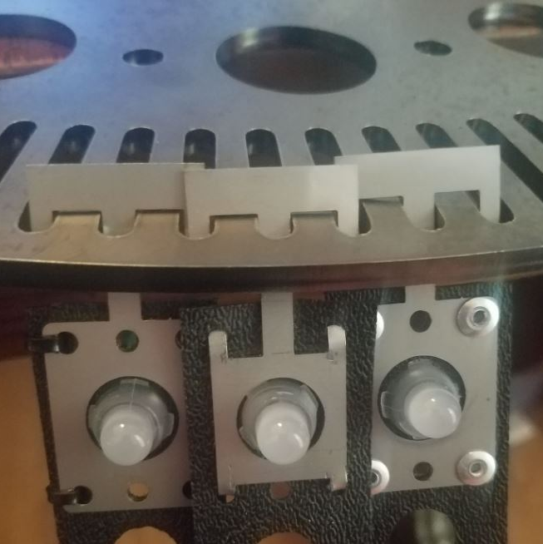
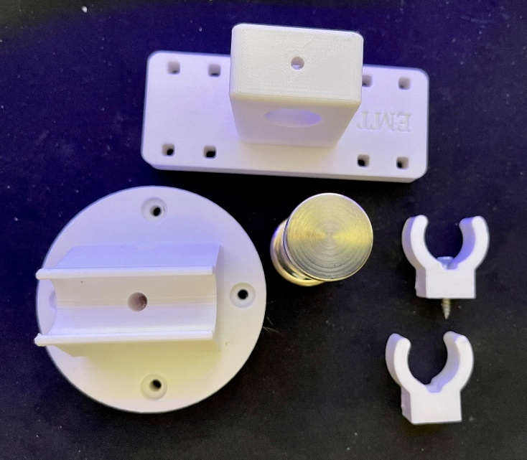
Lights / Props Controllers & Vendors
Controller
  Falcon, Kulp, Baldrick, Genius,
  Ready to run
  Build it yourself
Vendors
  Lights, wires and pigtails
  Coro
  3D printed mounts and tools
  Hardware / Mega Tree parts
  Enclosures and electrical supplies
  Sequences

Slide 11
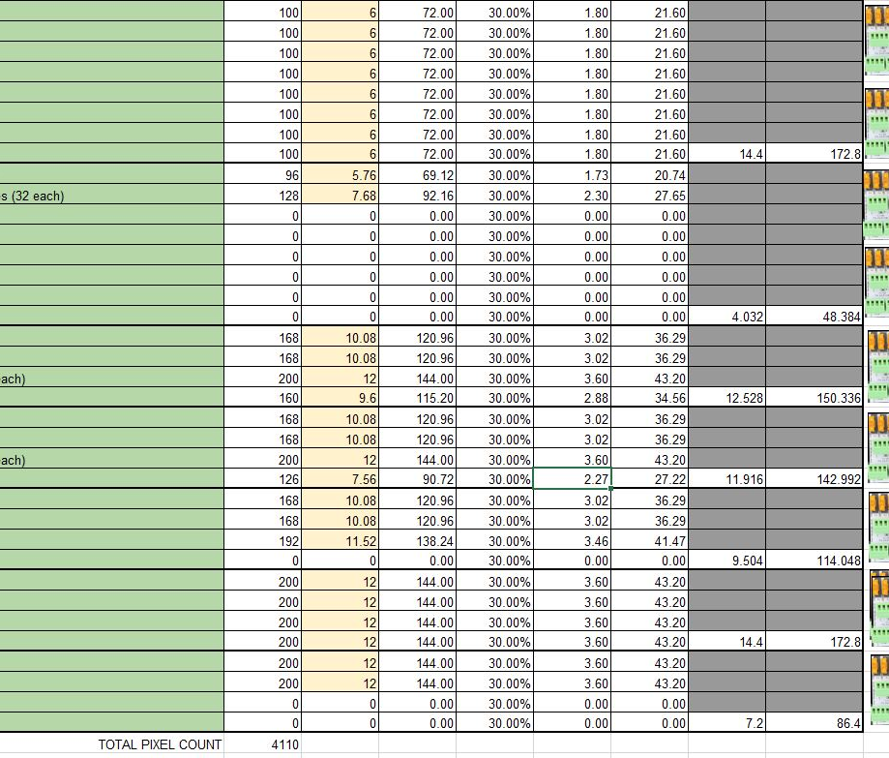
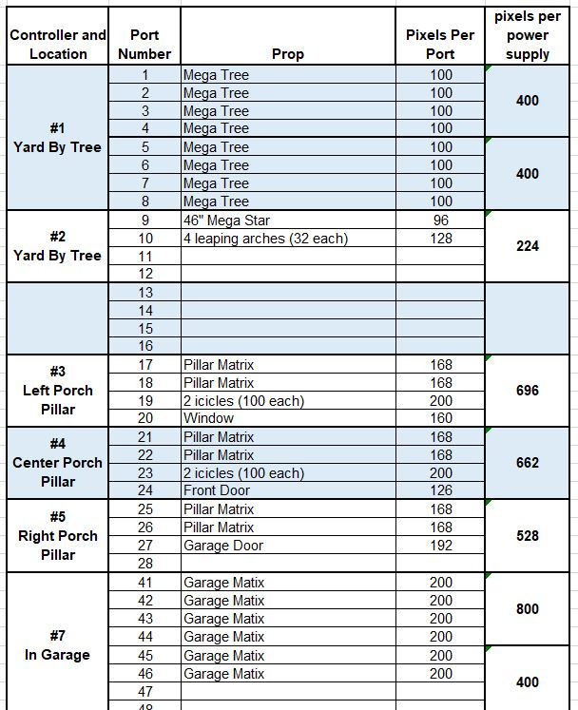
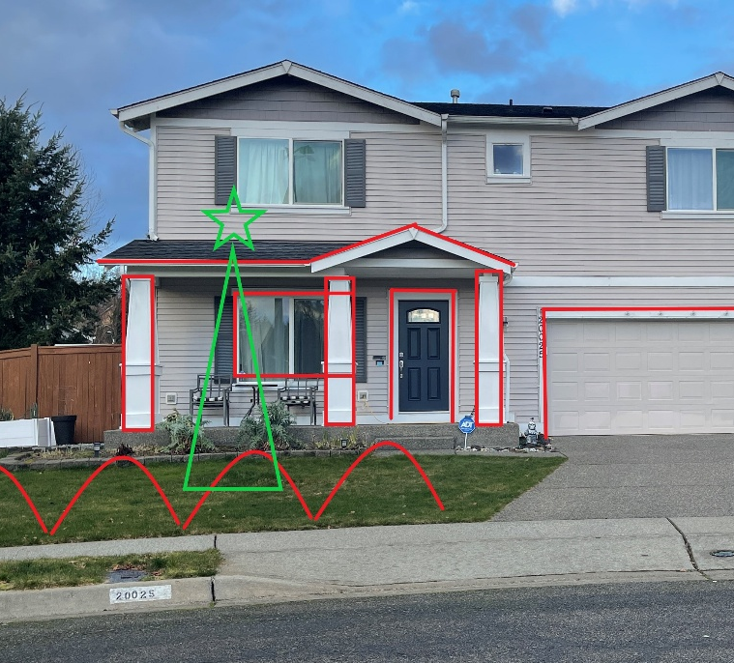
Putting your show on paper
Excel is your friend
Plan on future growth

Slide 12
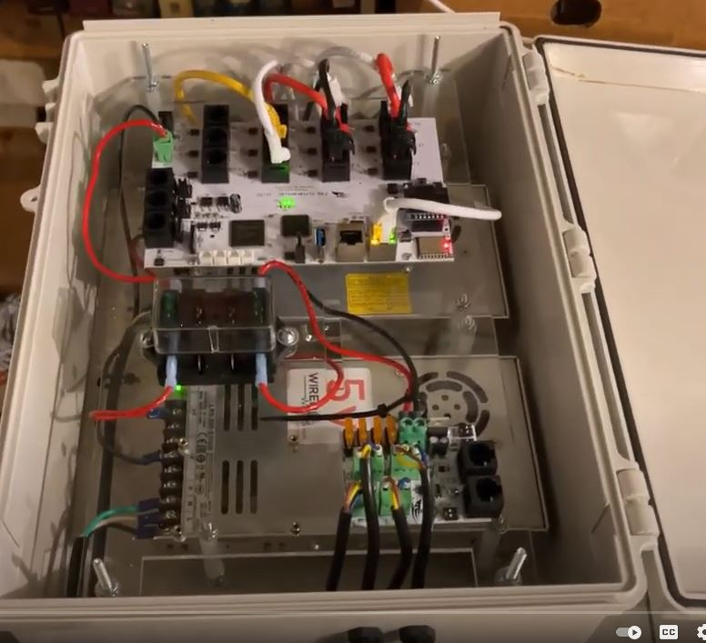

Determining what to order
Controllers ( prebuilt or DYI )
Lights
Props
Miscellaneous

Slide 13
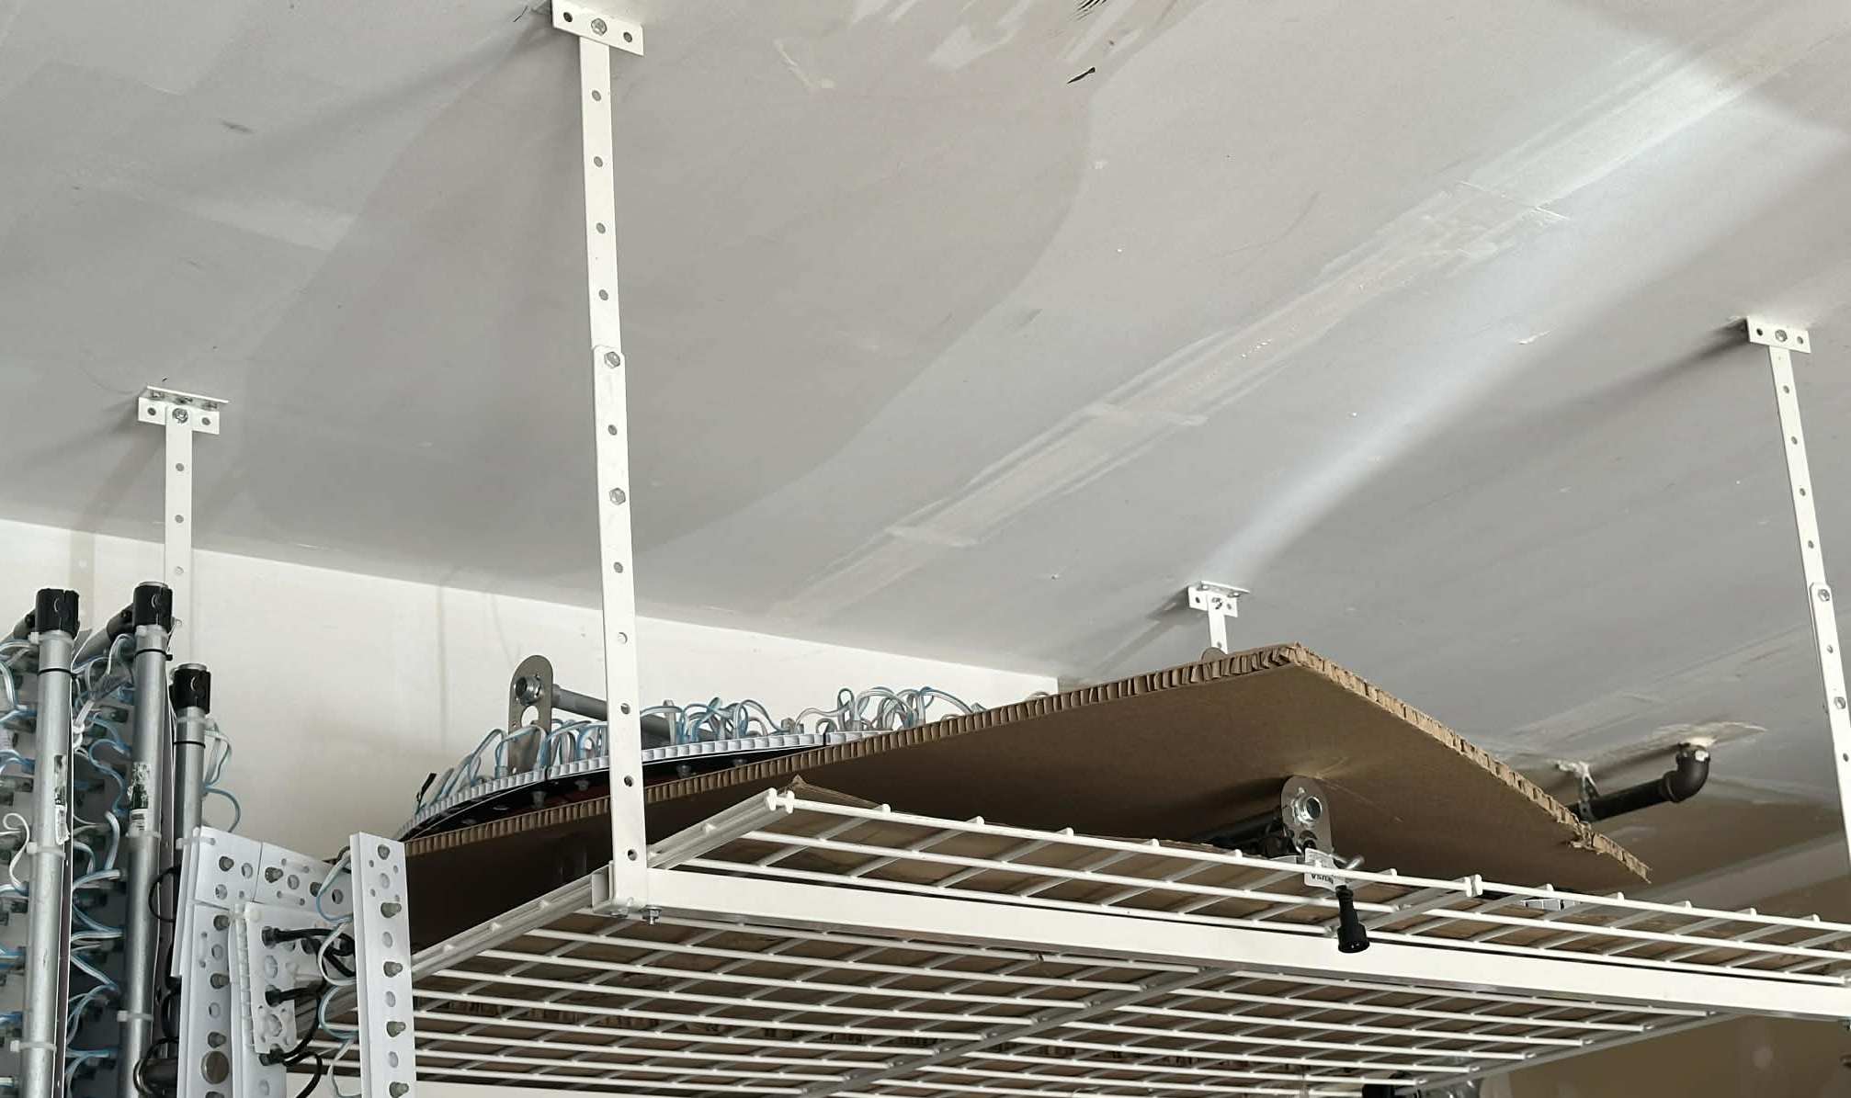
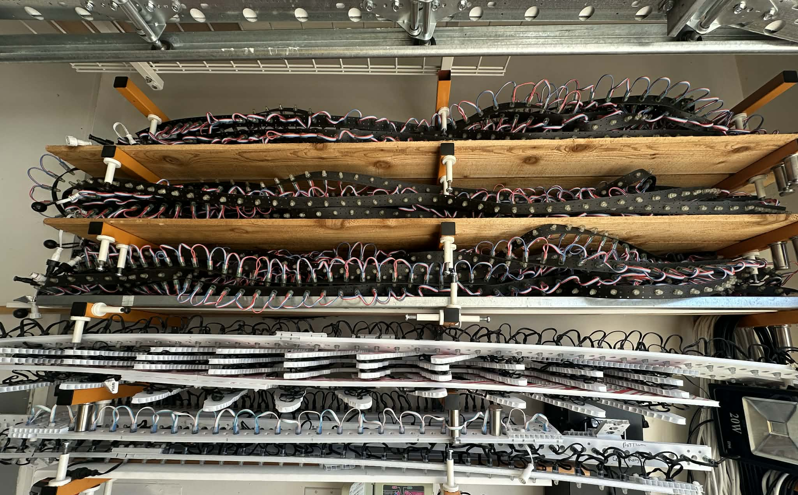
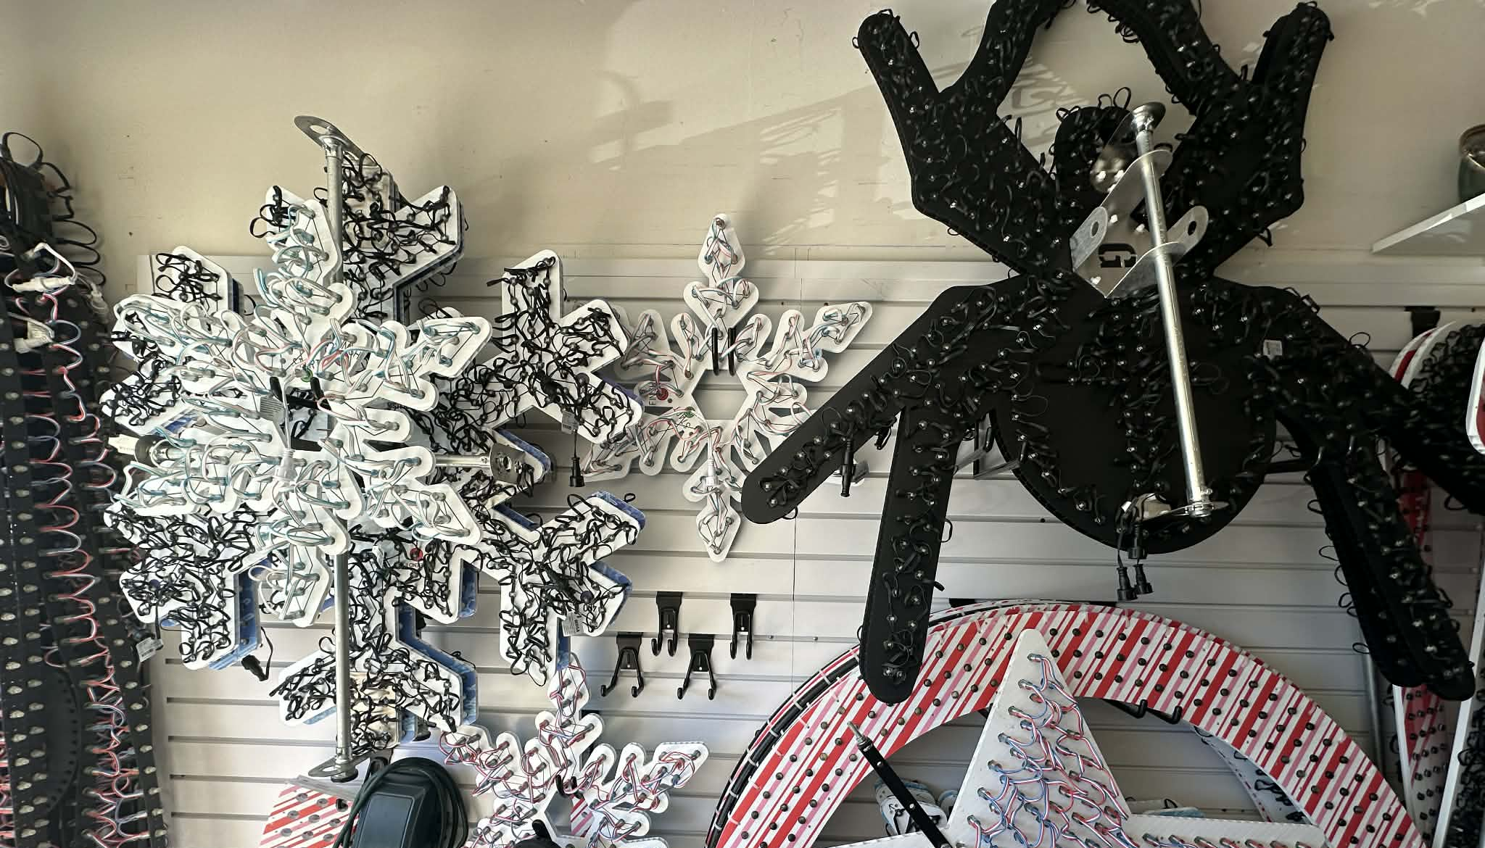
Storage
Slat wall
Overhead
Lumber racks
Avoid hot areas like Shed Lofts
Store coro hung or on a flat surface

Slide 14
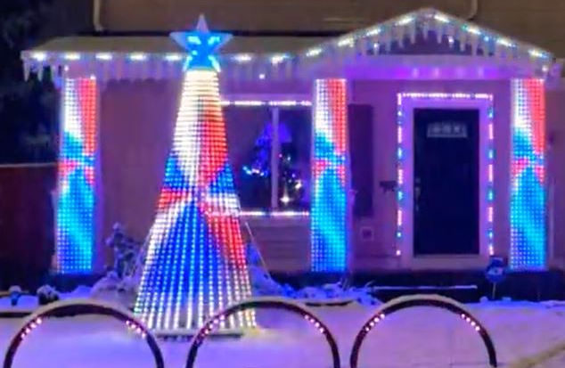
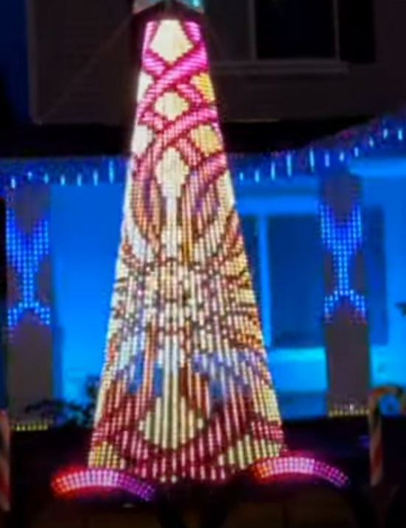
Center Piece, what's yours going to be.

Slide 15
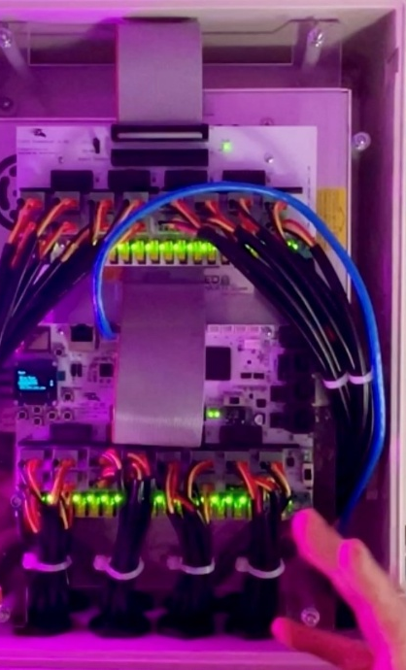

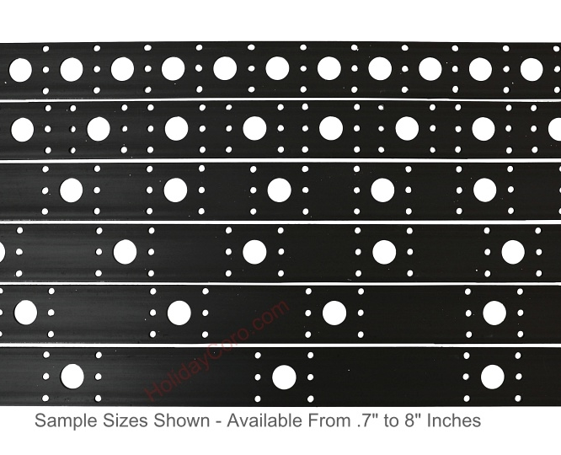
Things That Hight and Size Will Impact
Number of strips & pixel spacing
  50 Pixels at 2-inch spacing = 8.3 feet
  100 Pixels at 1-inch spacing = 8.3 Feet
  100 pixels at 1.5-inch spacing = 12.5 feet
  100 pixels at 2-inch spacing = 16.6 feet
Number of pixels
Number of controller ports and or power injection
Base ring size
Guy wires and anchoring

Slide 16
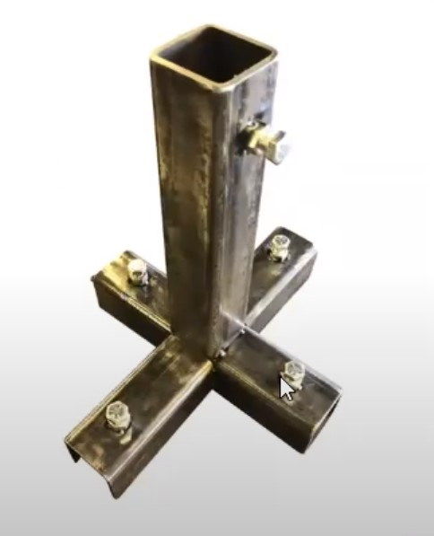
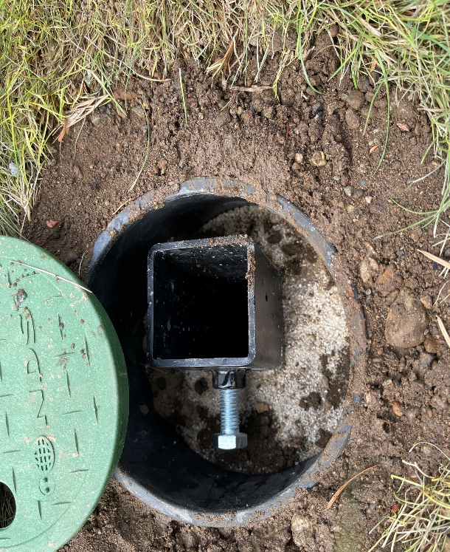
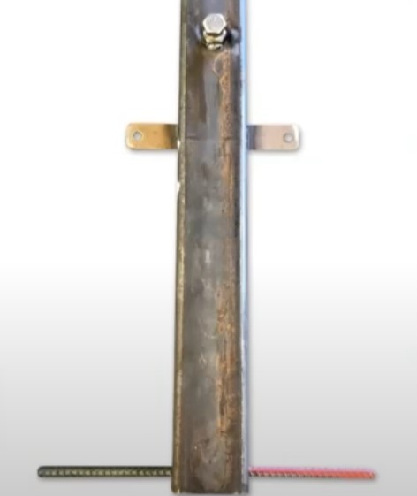
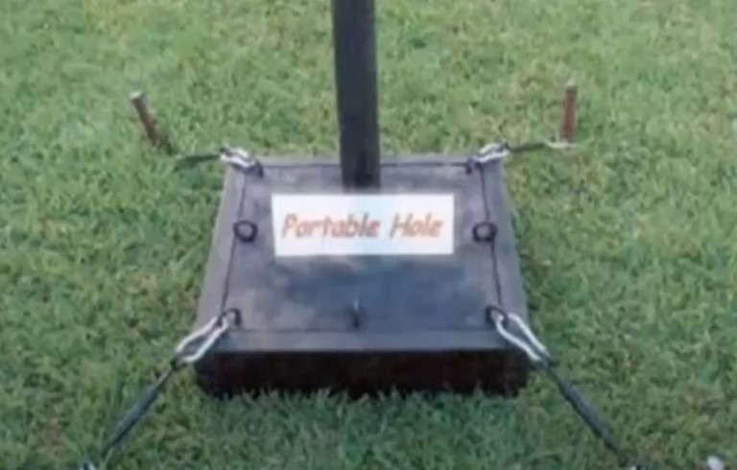
Base: In ground or portable hole
Yard sloped or level
Stationary or Freedom to move location
Threaded or Sleaved
Heavy, Wide or Anchored
Walter Monkhouse
http://www.magicchristmas.org/portable-hole.html

Slide 17
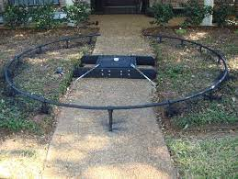
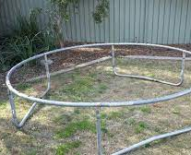
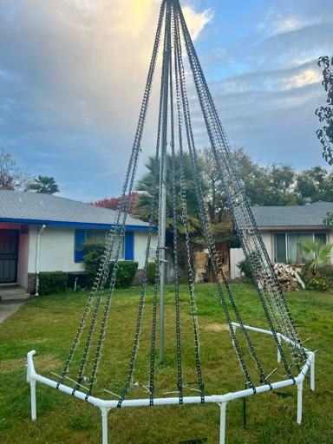
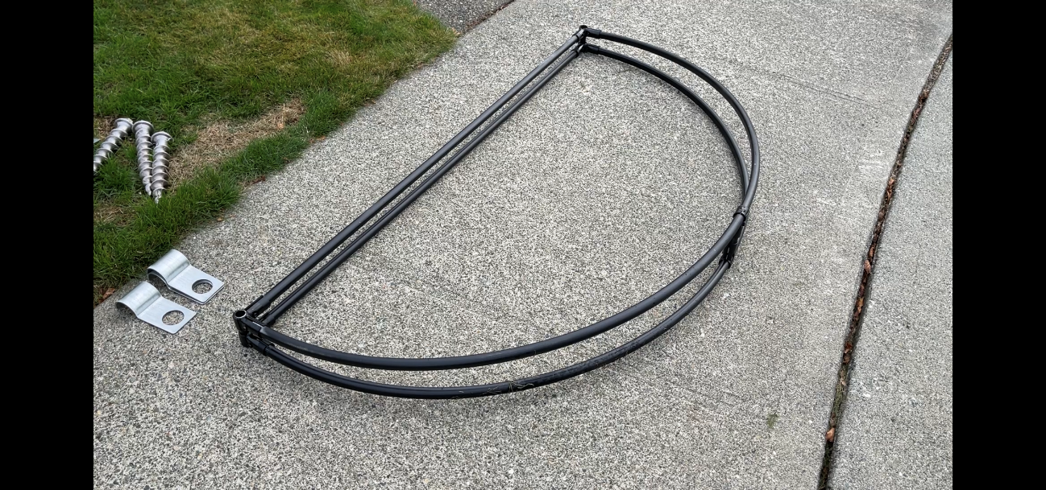
Base Ring
Yard sloped or level
Material
How it is anchored
How are you attaching your strips

Slide 18
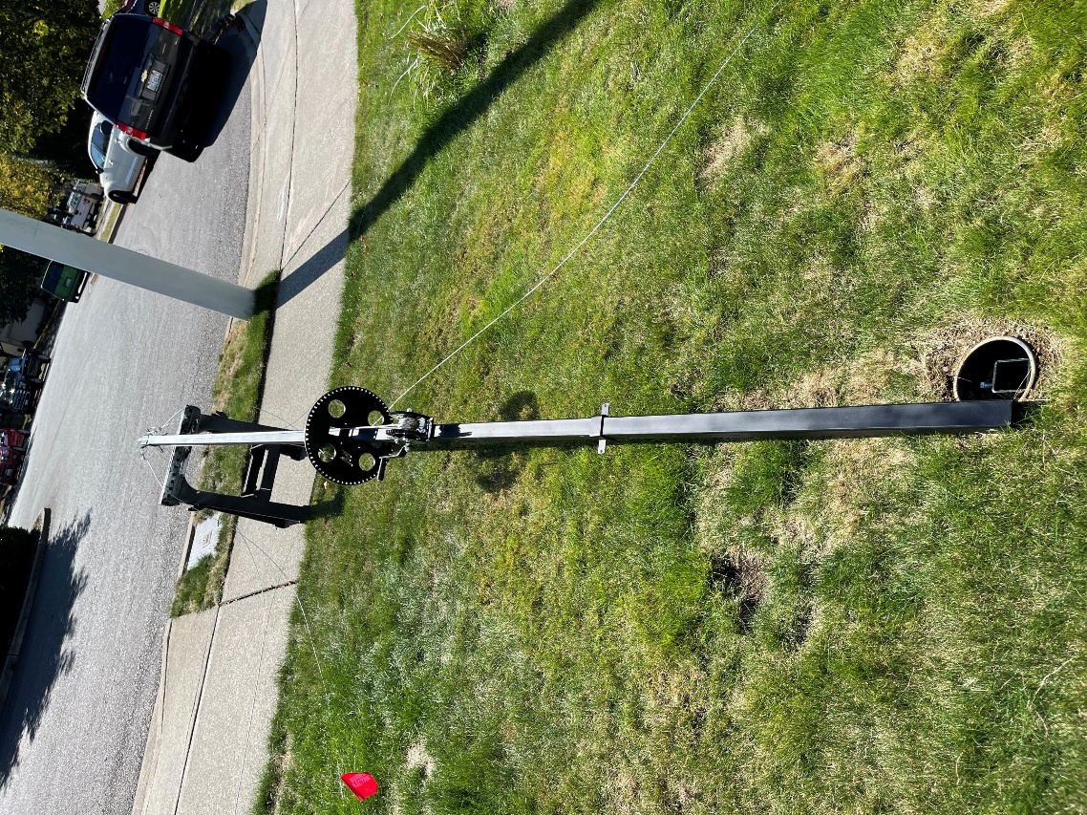
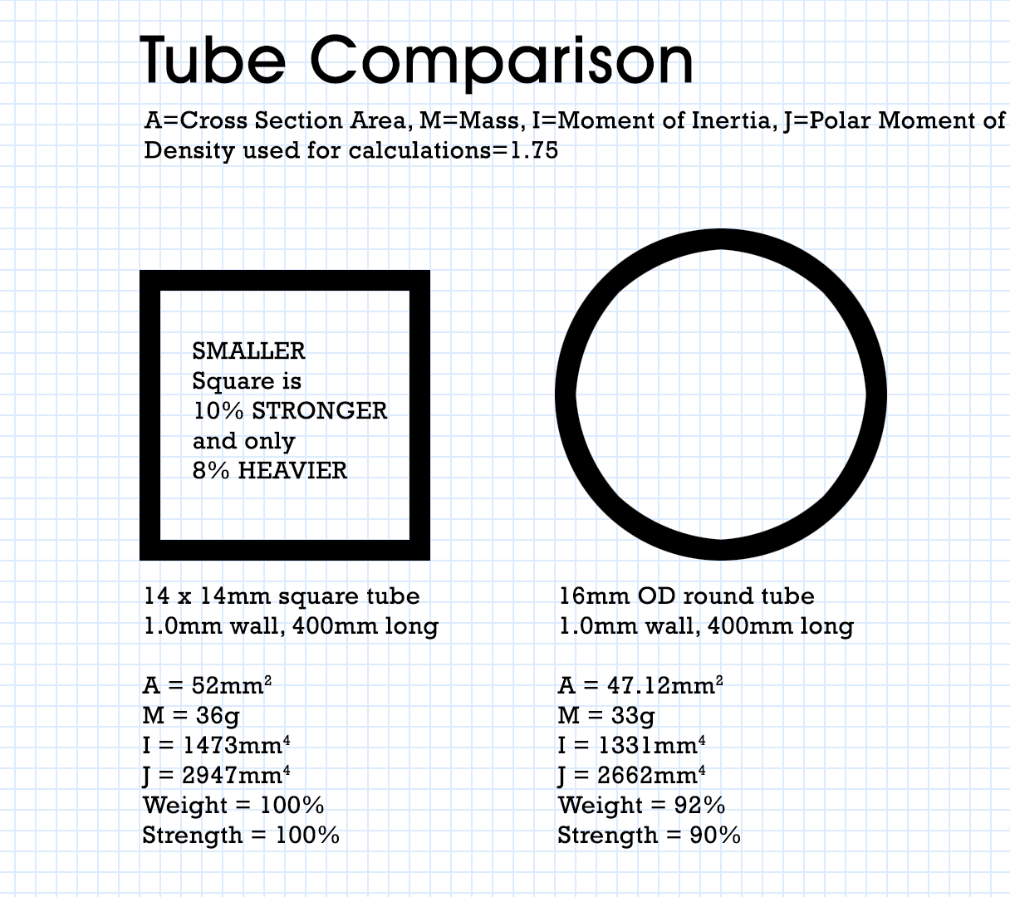
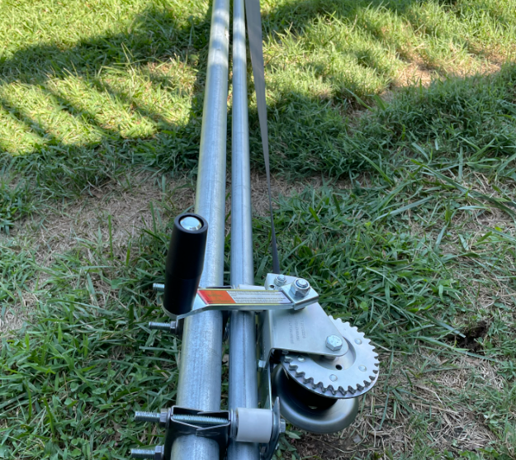
Pole: Single stage, double, square or round
Yard sloped or level
Stationary or Freedom to move location
Screwing it to the base or using a sleave
Pipe or Tube, Round or Square

Slide 19



Topper
  What is it made of.
  Think of the load on the topper
  360 or 180
  Slide or hard mount

Slide 20


Our Mattos Sasquatch Mega Tree
  Hight 12.5 Feet, 15.5 with star
  180 Degrees
  32 Strips, 100 lights per strip, 1.5 inch spacing
  Base is in ground
  Base ring 5 feet across
  Controller F16 V3 with 16 port expansion
  Build cost with controller $2,578

Slide 21




Mega Tree Safety

Slide 22



Guy Wire

Slide 23




Anchors

Slide 24



Before you dig Call 811

Slide 25



Safety
How high to you want to go
Should I rent a lift
Ladders, don’t go it alone
Cord management
Viewer safety

Slide 26



Time Management
Start early
Stick with a plan and set up the basics first
Multitasking
Take brakes

Slide 27



Where do I get Help
Xligths.org
Facebook groups
  Official Xlights Support Group
  FPP Falcon Player
  Xlights Holiday Lights Buy/Sell/Trade
  3D Printing For Christmas Light Enthusiast Group
  Holiday Lighting Think Tank
  Official xLights Sharing Group
YouTube Channels
  Canispater Christmas ( AKA Jeff )
  Keith Westley ( Xlights for Beginners )
  Xlights YouTube
  Counter Holiday Lights

Slide 28

Lorne Counter
Website: WWW.CounterHolidayLights.com
Email: Tbone3000@msn.com
YouTube Channel: WWW.Youtube.com/Counterholidaylights
  Or just search Counter Holiday Lights

Slide 29
Thank you for attending and being a part of the Christmas Expo family!

